Slide 1

A.V.C COLLEGE OF ENGINEERING IT6811 - PROJECT WORK - VIII Semester DEPARTMENT OF INFORMATION TECHNOLOGY
Project Title :
Multi-container Deployment on IoT Gateways
Guided by
Assistant Professor-IT

Slide 2
OBJECTIVE
To study containerized services to perform common gateway functions like device discovery, data management and cloud integration among others.
To reveal the advantages of having a containerized environment for IoT gateways.

Slide 3
INTRODUCTION
Notion of IoT has led to its application to various domains like health-care, autonomous transport, smart cities, among others which leverage the data generated from end devices to gain meaningful insights on the generated data.
We present AGILE, an open-source framework for IoT gateways offering services including device and protocol management, data storage, security and access control. AGILE is designed based on a microservice architecture with each of the services above deployed in separate containers.

Slide 4
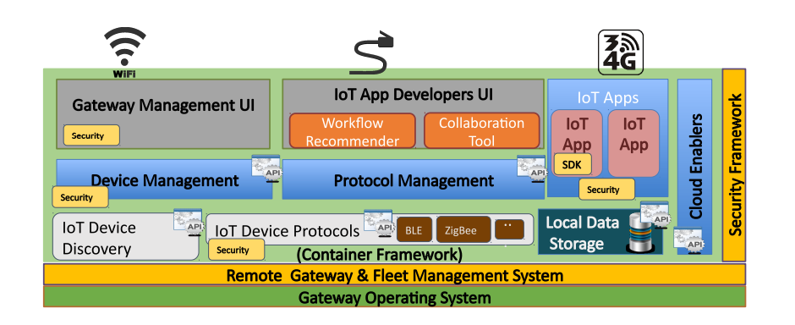
OVERVIEW OF AGILE MODULAR

Slide 5
AGILE FRAMEWORK
The AGILE gateway, which stands for an Adaptive & Modular Gateway for the IoT, was conceived to design and implement a truly modular gateway in terms of hardware and software and to be adaptive to handle various types of devices, networking interfaces, communication protocols, and use cases.

Slide 6
REQUIREMENTS
Software:
Languages Used :python
Tools Used : Opencv
Operating System :Stretch
Hardware:
Raspberry pi 3
Active/Passive buzzer
Sound sensor
Flame sensor
Humidity sensor
Laser Emitter

Slide 7
EXISTING SYSTEM
Different solutions for resource constrained WSNs, leveraging tiny virtual machines, have been developed, for example based on Java and Python execution environments, to enable programming of sensor nodes and code mobility.
These solutions are strictly dependent on the underlying virtualization environment. This aspect limits the flexibility in application development and potentially implies limiting code dependencies.

Slide 8
MODULES
Protocol Management
Local Data Storage
Gateway Management UI
IoT App Developers UI and SDK
Cloud Enablers

Slide 9
PLAN FOR FUTURE WORK
Address our research towards the evaluation of where accounting for both the impact of multiple containers running on the same device.
Further measurements on multiple devices and device architectures to improve our proposed optimization techniques.
We would also investigate optimization of pushing delta updates to the devices while minimizing the build and download times using the current study as a reference.

Slide 10
REFERENCES
L. Atzori, A. Iera, and G. Morabito, “The internet of things: A survey,” Computer networks, 2. Improving atm security via face recognition,K John Peter, G.Nagarajan , G.Gimini Sahaya Glory, Sanjana Devi.V.V
“Raspberry Pi.” https://www.raspberrypi.org/. Accessed: January 2017.
K. Hentschel, D. Jacob, J. Singer, and M. Chalmers, “Supersensors: Raspberry Pi Devices for Smart Campus Infrastructure,” in Future Internet of Things and Cloud (FiCloud), 2016 IEEE 4th International Conference on, pp. 58–62, IEEE, 2016.

Slide 11
THANK YOU

